Slide 1

CHAPTER SIX
Data
Business Intelligence
Notes:
It Takes A Village to Write an Encyclopedia
The invention of wiki technology and the Wikipedia encyclopedia is a great focus to start off your class. Start the class off by taking a brief tour of Wikipedia so students can see the online edits. Wikipedia is located at http://www.wikipedia.org/. Ask your students if they know which topic area has the largest number of daily changes? One of the hottest areas in Wikipedia is the Start Trek entries, which are changed more than any other topic area in the entire encyclopedia.
Wiki technology is taking off and people are finding new uses for the technology daily. Wiki is being used for collaboration among many businesses. Wiki is being used in education in a number of ways to support learning:
A teacher could post some key revision words for students to expand into definitions or pages
Students could work in groups on collaborative documents such as a group report
Course notes could be refined over the duration of the course by both students and teachers
Students could research new topics and contribute their findings
A wiki could be used as a portfolio showing development of a project
Teacher can start a writing prompt and have students add parts to create a comprehensive class writing activity.
A teacher could start a story and students could create links off it which would allow the story to follow different, interactive paths.
States and school districts can develop and edit curricula by allowing teachers to add in activities and assessments
A wiki would be a great tool for collaboratively constructing answers to exam questions!
A great tool for a team of students involved in project work
Annotating each other's work

Slide 2
Chapter Six Overview
SECTION 6.1 – DATA, INFORMATION, DATABASES
The Business Benefits of High-Quality Information
Storing Information Using a Relational Database Management System
Using a Relational Database for Business Advantages
Driving Websites with Data
SECTION 6.2 – BUSINESS INTELLIGENCE
Supporting Decisions with Business Intelligence
The Business Benefits of Data Warehousing
The Power of Big Data Analytics

Slide 3

Section 6.1
DATA, INFORMATION, AND DATABASES
Top Ten Data Failure Stories
10.博士幾乎是一個F：當一個糟糕的電源突然敲擊, 他的電腦擋了並損壞存儲文件的USB時，博士候選人丟失了他的整篇論文。如果數據沒有恢復，學生就不會畢業了。
9.遭遇的藝術：在重新整理家庭辦公室的同時，一名婦女不小心將一塊5磅厚的粘土陶器掉在她的筆記本電腦硬碟上，此硬碟裝有一本她已經修改五年的150年來的尚未印刷家譜圖片。
8.家庭困境：當丈夫意外按下計算機上的錯誤按鈕時，丈夫刪除了孩子的所有寶寶照片。如果他沒有把照片拿回來，他的妻子暗示要離婚。
7.咬比狗吠更糟糕：一位顧客掉下USB儲存碟，他的狗誤認為是咀嚼玩具。
6.不要在家裡嘗試這個：一個試圖從他的電腦上恢復資料的人發現這個工作過於挑戰，在中途結束未上軌的他完全拆卸的硬碟 。
5.超時：鐘錶製造商遭遇系統擋機，失去了所有時鐘的數位設計。 實際上擊跨了時鐘的數位設計資料復原，以致無法進行重要的國際貿易展。
4.鑽取數據：在多驅動器RAID硬碟恢復期間，工程師發現缺少屬於該集合的一個驅動器硬碟。客戶在垃圾箱中找到了丟失的驅動器硬碟，但是根據公司處理舊驅動器硬碟的政策，它必有一個鑽孔洞。
3.安全在家：經過他們中的一位高階主管遭遇筆記本電腦故障後，明尼蘇達雙城職業棒球隊呼籲進行拯救關於他們最新取得的重要偵察資訊。該團隊現在依靠其偵察資訊和教練團中進行所有數據恢復。
2.硬碟問題：一個沮喪的作家用錘子襲擊了她的電腦。當工程師收到電腦時，頂蓋上清晰可見錘子印記。
1. La Cucaracha：為了挽救有價值的公司信息，一位客戶將一個已閒置10年的倉庫中拉出一台舊筆記本電腦。當工程師打開計算機時，它包含數百個死亡和腐爛的蟑螂殼。
Notes:
CLASSROOM OPENER
Top Ten Data Failure Stories
10. PhD Almost an F: A PhD candidate lost his entire dissertation when a bad power supply suddenly zapped his computer and damaged the USB Flash drive that stored the document. Had the data not been recovered, the student would not have graduated.
9. Suffering from Art: While rearranging her home office, a woman accidentally dropped a five pound piece of clay pottery on her laptop, directly onto the hard drive area that contained a book she'd been working on for five years and 150 year-old genealogy pictures that had not yet been printed.
8. Domestic Dilemma: A husband deleted all of his child's baby pictures when he accidentally hit the wrong button on his computer. His wife hinted at divorce if he did not get the pictures back.
7. Bite Worse than Bark: A customer left his memory stick lying out and his dog mistook it for a chew toy.
6. Don't Try this at Home: A man attempting to recover data from his computer on his own found the job too challenging mid-way through and ended up sending Ontrack his completely disassembled drive -- with each of its parts in a separate baggie.
5. Out of Time: A clockmaker suffered a system meltdown, losing the digital designs for all of its clocks. Ontrack literally beat the clock recovering all their data just in time for an important international tradeshow.
4. Drilling for Data: During a multi-drive RAID recovery, engineers discovered one drive belonging in the set was missing. The customer found the missing drive in a dumpster, but in compliance with company policy for disposing of old drives, it had a hole drilled through it.
3. Safe at Home: After one of their executives experienced a laptop crash, the Minnesota Twins professional baseball team called on Ontrack to rescue crucial scouting information about their latest prospects. The team now relies on Ontrack for all data recoveries within its scouting and coaching ranks.
2. Hardware Problems: A frustrated writer attacked her computer with a hammer. When the engineers received the computer, the hammer imprint was clearly visible on the top cover.
1. La Cucaracha: In hopes of rescuing valuable company information, a customer pulled an old laptop out of a warehouse where it had been sitting unused for 10 years. When engineers opened the computer, it contained hundreds of husks of dead and decaying cockroaches.

Slide 4
Learning Outcomes 1 of 2
6.1 Explain the four primary traits that determine the value of information.
6.2 Describe a database, a database management system, and the relational database model.
6.3 Identify the business advantages of a relational database.
6.4 Explain the business benefits of a data-driven website.

Slide 5
The Business Benefits of High-Quality Information
Information is everywhere in an organization
Employees must be able to obtain and analyze the many different levels, formats, and granularities of organizational information to make decisions
Successfully collecting, compiling, sorting, and analyzing information can provide tremendous insight into how an organization is performing
仔細查看組織信息可能會產生令人興奮和出乎意料的結果，例如潛在的新市場，新的吸引客戶的方式，甚至是新的經商方式
Notes:
Granularity refers to the extent of detail within the information (fine and detailed or “coarse” and abstract information)
Have you ever had to correlate two different formats, levels, or granularities of information?
How did you correlate the information?
Taking a hard look at organizational information can yield exciting and unexpected results such as potential new markets, new ways of reaching customers, and even new ways of doing business

Slide 6
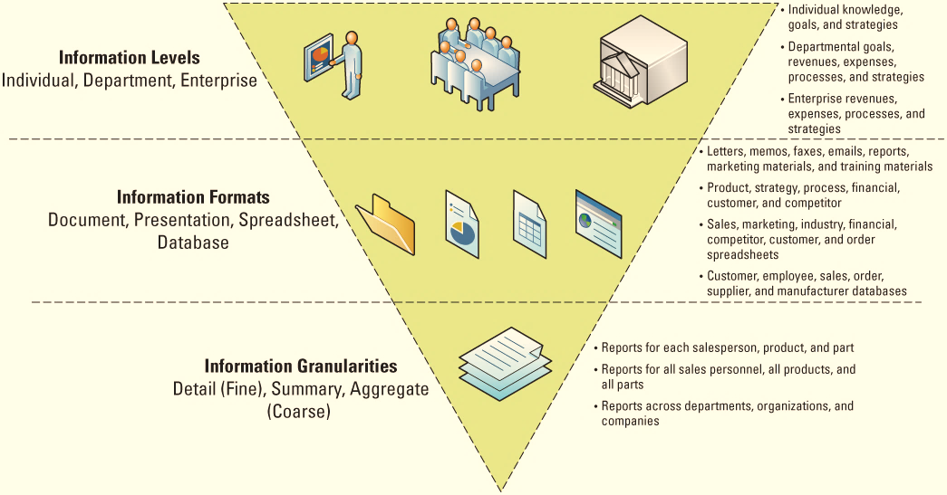
Figure 6.1 Levels, Formats, and Granularities of Organizational Information
Jump to long image description

Slide 7
Information Type: Transactional and Analytical
Transactional information – Encompasses all of the information contained within a single business process or unit of work, and its primary purpose is to support the performing of daily operational tasks
Analytical information – Encompasses all organizational information, and its primary purpose is to support the performing of managerial analysis tasks
Analytical information
is used to make ad-hoc decisions,
includes external organizational information
include cost/benefit analysis, sales forecast, market trends, industry trends, and regulations
Notes:
Transactional information examples include withdrawing cash from an ATM, making an airline reservation, purchasing stocks
Compile a list of additional transactional information examples
These could include daily sales, hourly employee payroll, product orders, shipping an order
Analytical information includes transactional information
Analytical information also includes external organizational information such as market, industry, and economic conditions
Analytical information is used to make ad-hoc decisions
Analytical information examples include trends, sales, product statistics, and future growth projections
Compile a list of additional analytical information examples
These could include cost/benefit analysis, sales forecast, market trends, industry trends, and regulations

Slide 8
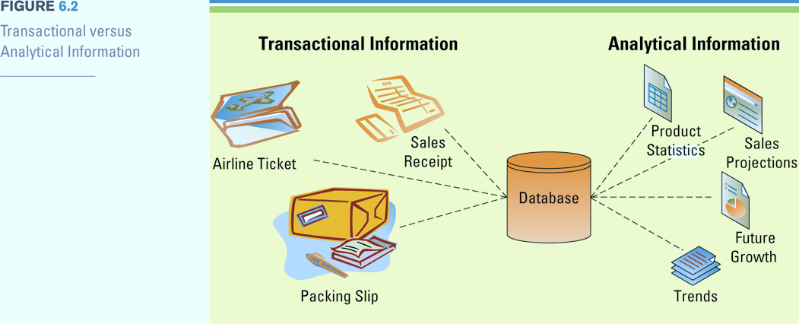
Figure 6.3 Transactional versus Analytical Information
Packing slip 裝箱單
Notes:
Organizations capture and store transactional information in databases and use it when performing operational tasks and repetitive decisions such as analyzing daily sales reports and production schedules
Ask your students to compile a list of the different types of ad-hoc decisions a business might base on analytical information
These could include building a new plant, hiring or reducing workforces, introducing a new product

Slide 9
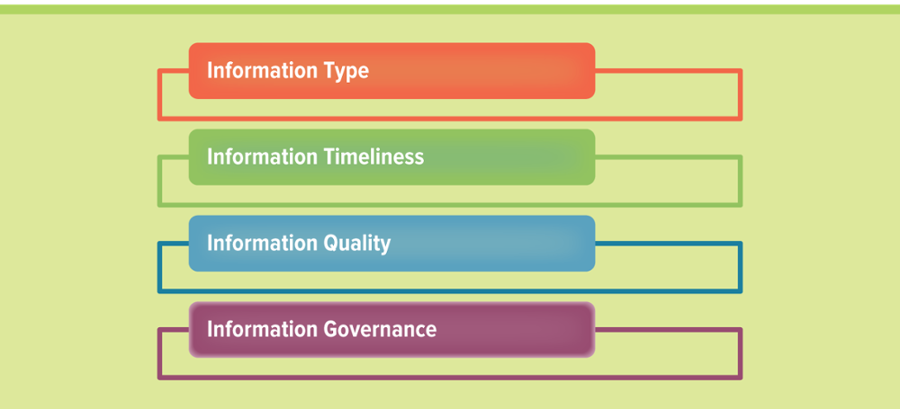
Figure 6.2 The Four Primary Traits of the Value of Information
Transactional and Analytical
timeliness及时
Notes:
The four primary traits of the value of information
Ask your students to differentiate between the four types and provide an example of each
Type
Timeliness
Quality
Governance

Slide 10
Information Timeliness
Timeliness is an aspect of information that depends on the situation
Real-time information – Immediate, up-to-date information
Real-time system – Provides real-time information in response to requests
Organizations such as 911 centers, stock traders, and banks require up-to-the second information
Notes:
The important point that students must understand regarding timely information is that “timely” is relative to each business decision
Some decisions require weekly information while others require daily information
Organizations such as 911 centers, stock traders, and banks require up-to-the second information
CLASSROOM EXERCISE
Timing Time
Break your students into groups and ask them to compile a list of three business decisions that require up-to-the-second information, three business decisions that require quarterly information, and three business decisions that require yearly information. Have your students present their answers to the class.

Slide 11
Information Quality 1 of 2
Business decisions are only as good as the quality of the information used to make the decisions
You never want to find yourself using technology to help you make a bad decision faster
Information inconsistency
Information integrity issues
Information inconsistency occurs when the same data element has different values. for example, the amount of work that needs to occur to update a customer who had changed her last name due to marriage. Changing this information in only a few organizational systems will lead to data inconsistencies, causing customer 123456 to be associated with two last names.
Information integrity issues occur when a system produces incorrect, inconsistent, or duplicate data. Data integrity issues can cause managers to consider the system reports invalid and make decisions based on other sources.
Notes:
Information inconsistency occurs when the same data element has different values. Take, for example, the amount of work that needs to occur to update a customer who had changed her last name due to marriage. Changing this information in only a few organizational systems will lead to data inconsistencies, causing customer 123456 to be associated with two last names.
Information integrity issues occur when a system produces incorrect, inconsistent, or duplicate data. Data integrity issues can cause managers to consider the system reports invalid and make decisions based on other sources.
Do you have any examples of a time when you encountered a problem due to low quality information?
For example, you did not receive a package because the address was incorrect or missing
List the business ramifications that can occur for an organization that maintains low quality information
What is the expense to a business that provides its employees with hourly updates, when the employees only require weekly updates?
Updating information costs money
Updated information must be stored; the more frequently an organization updates its information, the more information they will have in their data warehouse and databases
Updating information changes information
Review the scenario in the text that discusses three managers who make different business decisions based on the same report
The reason for the different business decisions is because the managers pulled the report at three different times during the day
Since the information was continually being updated, they came to different conclusions

Slide 12
Information Quality 2 of 2
Characteristics of high-quality information
Accurate
Complete
Consistent
Unique
Timely
Accuracy: Are all the values correct? For example, is the name spelled correctly? Is the dollar amount recorded properly?
Completeness: Are any of the values missing? For example, is the address complete including street, city, state, and zip code?
Consistency: Is aggregate or summary information in agreement with detailed information?
Uniqueness: Is each transaction, entity, and event represented only once in the information? For example, are there any duplicate customers?
Timeliness Is the information current with respect to the business requirements?
Notes:
Characteristics of High Quality Information
Accuracy: Are all the values correct? For example, is the name spelled correctly? Is the dollar amount recorded properly?
Completeness: Are any of the values missing? For example, is the address complete including street, city, state, and zip code?
Consistency: Is aggregate or summary information in agreement with detailed information?
For example, do all total fields equal the true total of the individual fields?
Uniqueness: Is each transaction, entity, and event represented only once in the information?
For example, are there any duplicate customers?
Timeliness Is the information current with respect to the business requirements? For example, is information updated weekly, daily, or hourly?
CLASSROOM EXERCISE
Inquiring about Information
Break your students into groups and ask each group to provide an additional example of each of the five common characteristics of high quality information that is not provided in the above figure
For example, Accuracy: does a purchase price on a bill match the item description on the bill?
Item 1: Kids juice cup, cost $10,000
Chances are a kids juice cup would not cost $10,000 and this is an inaccurate item

Slide 13
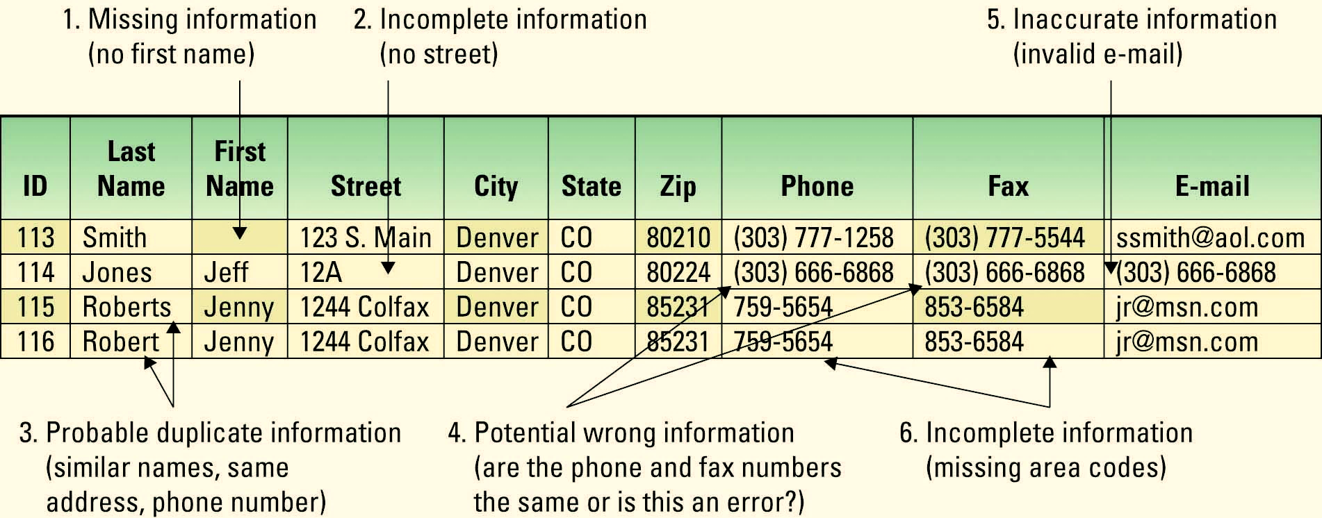
Figure 6.5 Example of Low-Quality Information
Jump to long image description
Notes:
Walk-through each of the six issues and have your students extrapolate a potential business problem that might be associated with each issue. The example does not state what type of database or spreadsheet this information is contained (sales, marketing, customer service, billing, etc), so allow your students use their imagination when they are extrapolating the potential business problems
Issue 1: Without a first name it would be impossible to correlate this customer with customers in other databases (Sales, Marketing, Billing, Customer Service) to gain a compete customer view (CRM)
Issue 2: Without a complete street address there is no possible way to communicate with this customer via mail or deliveries. An order might be sitting in a warehouse waiting for the complete address before shipping. The company has spent time and money processing an order that might never be completed
Issue 3: If this is the same customer, the company will waste money sending out two sets of promotions and advertisements to the same customers. It might also send two identical orders and have to incur the expense of one order being returned
Issue 4: This is a good example of where cleaning data is difficult because this may or may not be an error. There are many times when a phone and a fax have the same number. Since the phone number is also in the e-mail address field, chances are that the number is inaccurate
Issue 5: The business would have no way of communicating with this customer via e-mail
Issue 6: The company could determine the area code based on the customer’s address. This takes time, which costs the company money. This is a good reason to ensure that information is entered correctly the first time. All incorrect information needs to be fixed, which costs time and money

Slide 14
Understanding the Costs of Using Low-Quality Information 1 of 2
The four primary sources of low quality information:
Customers intentionally enter inaccurate information to protect their privacy
Different entry standards and formats
Operators enter abbreviated or erroneous information by accident or to save time
Third party and external information contains inconsistencies, inaccuracies, and errors
Notes:
Addressing the above sources of information inaccuracies will significantly improve the quality of organizational information
Determine a few additional sources of low quality information
A customer service representative could accidentally transpose a number in an address or misspell a last name

Slide 15
Understanding the Costs of Using Low-Quality Information 2 of 2
Potential business effects resulting from low quality information include:
Inability to accurately track customers
Difficulty identifying valuable customers
Inability to identify selling opportunities
Marketing to nonexistent customers
Difficulty tracking revenue
Inability to build strong customer relationships
Data gap analysis – Occurs when a company examines its data to determine if it can meet business expectations, while identifying possible data gaps or where missing data might exist
Notes:
Can you list any additional business effects resulting from poor information? (focus on organizational strategies such as SCM, CRM, and ERP)
Poor information could cause the SCM system to order too much inventory from a supplier based on inaccurate orders
Poor information could cause a CRM system to send an expensive promotional item (such as a fruit basket) to the wrong address of one of its best customers
What occurs when you have the inability to build strong customer relationships?
Increase buyer power

Slide 16
Understanding the Benefits of Good Information
High quality information can significantly improve the chances of making a good decision
Good decisions can directly impact an organization's bottom line盈虧、利潤
A data steward is responsible for ensuring data policies and procedures are implemented across an organization
Steward管理员 stewardshp管理工作
Notes:
CLASSROOM EXERCISE
Understanding Information’s Quality
Break your students into groups and ask them to compile a list of all of the issues found in the following information (the table is located in the IM. Cut and paste onto a slide or display on the projector)
Ask your students to also list why most low quality information errors occur and what an organization can do to help implement high quality information
Data stewardship is the management and oversight of an organization's data assets to help provide business users with high-quality data that is easily accessible in a consistent manner.
A data steward is responsible for ensuring the policies and procedures are implemented across the organization and acts as a liaison between the MIS department and the business.

Slide 17
Information Governance
Data governance – Refers to the overall management of the availability, usability, integrity, and security of company data
Master data management (MDM) – The practice of gathering data and ensuring that it is uniform, accurate, consistent, and complete, including such entities as customers, suppliers, products, sales, employees, and other critical entities that are commonly integrated across organizational systems
Data validation – Includes the tests and evaluations used to determine compliance with data governance polices to ensure correctness of data
Notes:
Ask your students why information governance is a much needed focus area for all businesses

Slide 18
Storing Information in a Relational Database 1 of 2
Information is everywhere in an organization
Information is stored in databases
Database – Maintains information about various types of objects (inventory), events (transactions), people (employees), and places (warehouses)
What kinds of databases can be found around your college?
Student registration
Course evaluation
Payroll
Parking services
Notes:
How many of you are familiar with databases?
What kinds of databases can be found around your college?
Student registration
Course evaluation
Payroll
Parking services
Explain to your students that almost every business decision is based on information
The information required to make these decisions is typically stored in databases

Slide 19
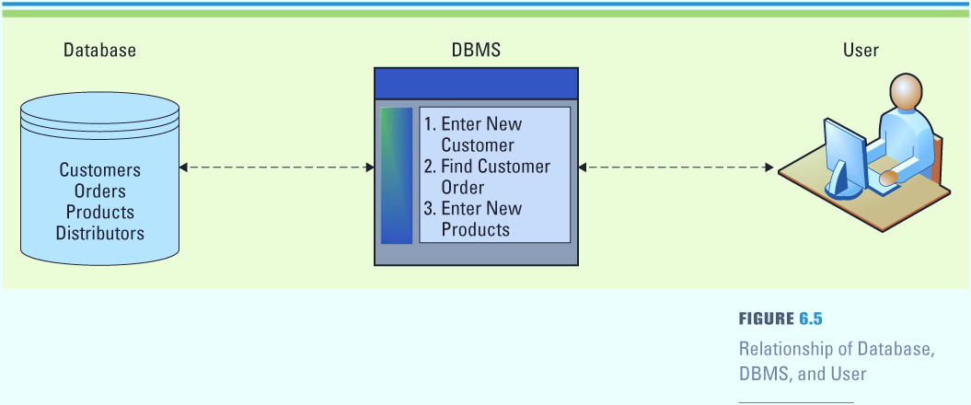
Figure 6.6 Relationship of Database, DBMS, and User
Database management systems (DBMS) – Allows users to create, read, update, and delete data in a relational database
Jump to long image description
Notes:
Relationship of a database with a DBMS
The user interacts directly with the DBMS
The DBMS obtains the information from the database
Ask your students if they have interacted with an application that used a database?
Payroll system
Course scheduling system

Slide 20
Storing Information in a Relational Database 2 of 2
Data element – The smallest or basic unit of information處理學生的資料為例，可將學生的姓名、學號、生日等作為資料單元。
Data model – Logical data structures that detail the relationships among data elements using graphics or pictures
Metadata – Details about data詮釋資料,有關資料的資料
Data dictionary – Compiles all of the metadata about the data elements in the data model
Notes:
Relationship of a database with a DBMS
The user interacts directly with the DBMS
The DBMS obtains the information from the database
Ask your students if they have interacted with an application that used a database?
Payroll system
Course scheduling system

Slide 21
Storing Data Elements in Entities and Attributes
Entity – A person, place, thing, transaction, or event about which information is stored
The rows in a table contain entities
Attribute (field, column) – The data elements associated with an entity
The columns in each table contain the attributes
Record – A collection of related data elements
Notes:
This text focuses on the relational database model
What kinds of additional entities might be found in this database?
INVENTORY, MARKETING CAMPAIGN, SALES PRICE, CUSTOMER INFORMATION, PAYMENT INFORMATION
What kinds of additional attributes might be found in the MUSICIAN table?
Could include any additional musician information:
MusicianBand
MusicianEducation
MusicianAge
MusicianGender

Slide 22
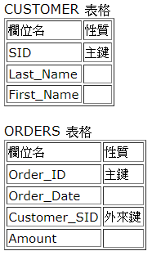
Creating Relationships Through Keys
Primary keys and foreign keys identify the various entities (tables) in the database
Primary key – A field (or group of fields) that uniquely identifies a given entity in a table主鍵 (Primary Key) 中的每一筆資料都是表格中的唯一值。換言之，它是用來獨一無二地確認一個表格中的每一行資料。主鍵可以是原本資料內的一個欄位。主鍵可以包含一或多個欄位。當主鍵包含多個欄位時，稱為組合鍵
Foreign key – A primary key of one table that appears an attribute in another table and acts to provide a logical relationship among the two tables外來鍵是一個(或數個)指向另外一個表格主鍵的欄位。外來鍵的目的是確定資料的參考完整性 (Referential Integrity)。換言之，只有被准許的資料值才會被存入資料庫內。
Notes:
Explain to your students that the logic that correlates the tables is implemented through the primary keys
For example: Hawkins Shipping in the DISTRIBUTOR table has a primary key called Distributor ID – DEN8001
Notice that Hawkins Shipping (Distributor ID DEN8001) is responsible for delivering orders 34561 and 345652
Therefore, Distributor ID in the ORDER table creates a logical relationship (who shipped what order) between ORDER and DISTRIBUTOR
CLASSROOM EXERCISE
Building an ER Diagram
Break your students into groups and ask them to create an entity relationship diagram similar to the one in the Coca-Cola bottling company ERD for a company or product of their choice. If the students are uncomfortable with databases, you should recommend that they stick to a company similar to the TCCBCE, perhaps a snack food producer, mountain bike equipment producer, or even a footwear producer. If your students are more comfortable with databases, ask them to choose a company that would challenge them such as a fast food restaurant, online book seller, or even a university’s course registration system.
The important part of this exercise is for your students to begin to understand how the tables in a database relate. Be sure their ER diagrams include primary keys and foreign keys. Have your students present their ER diagrams to the class and ask the students to find any potential errors with the diagrams.

Slide 23
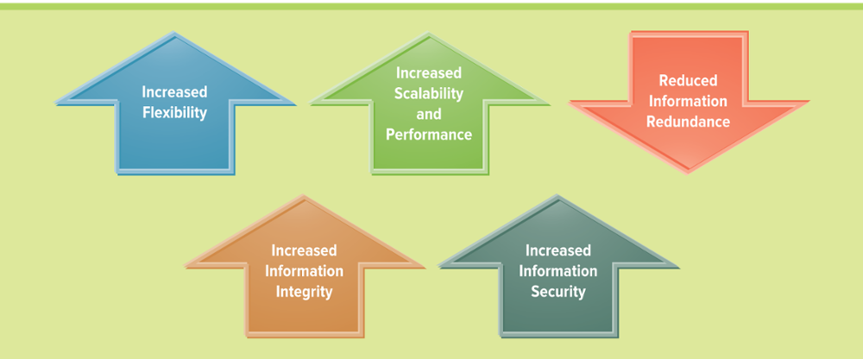
Figure 6.9 Business Advantages of a Relational Database
What are the limitations when using a spreadsheet?
Limited number of rows and columns (Excel: 65,536 rows by 256 columns) Once you use more than 65,536 rows you have outgrown your spreadsheet
Only one users can access the spreadsheet
Users can view all information in the spreadsheet
Users can change all information in the spreadsheet
Jump to long image description
Notes:
All of the above are discussed in the following slides:
A good way to explain databases is to compare them to spreadsheets
What are the limitations when using a spreadsheet?
Limited number of rows and columns (Excel: 65,536 rows by 256 columns) Once you use more than 65,536 rows you have outgrown your spreadsheet
Only one users can access the spreadsheet
Users can view all information in the spreadsheet
Users can change all information in the spreadsheet
All of the disadvantages associated with a spreadsheet are fixed when using a database
These advantages are discussed in detail over the next several slides

Slide 24
Increased Flexibility
A well-designed database should:
Handle changes quickly and easily
Provide users with different views
Have only one physical view – Deals with the physical storage of information on a storage device
Have multiple logical views – Focuses on how individual users logically access information to meet their own particular business needs
Notes:
The separation between logical and physical views is what allows each user to access database information differently
What would happen if a new database called “RealData” hit the market and allowed only one logical view?
The “RealData” database simply would never sell. With only one logical view every person in an entire organization would have the same view
Define two database views for your school’s student database (one for students, and one for instructors)
What does the student view display when a student accesses the school’s student database?
Courses enrolled
Grades
Tuition
Credits for graduation
What does the instructor view display when an instructor accesses the school’s student database?
Courses teaching
Students in each course
Payment information
Vacation time

Slide 25
Increased Scalability and Performance
A database must scale延展to meet increased demand, while maintaining acceptable performance levels
Scalability – Refers to how well a system can adapt to increased demands
Performance – Measures how quickly a system performs a certain process or transaction
What happens to a business if its suddenly experienced a 60 percent growth in sales and its IT systems fail with all of the increased activity?
Notes:
What happens to a business if its suddenly experienced a 60 percent growth in sales and its IT systems fail with all of the increased activity?
Remind your students that a big part of developing successful IT systems is being able to anticipate future growth

Slide 26
Reduced Information Redundancy
Databases reduce information redundancy
Information redundancy – The duplication of data or storing the same information in multiple places
Inconsistency is one of the primary problems with redundant information
Notes:
One of the primary goals of a database is to eliminate information redundancy by recording each piece of information in only one place
This is a good time to tie the discussion back to the material in the previous chapter, low quality information
Recall what happens when a single customer is stored twice with different phone numbers, addresses, or order information in a single database

Slide 27
Increase Information Integrity (Quality)
Information integrity – measures the quality of information
Integrity constraint – rules that help ensure the quality of information
Relational integrity constraint
Business-critical integrity constraint
Relational integrity constraint: rule that enforces basic and fundamental information-based constraints
e.g. Users cannot create an order for a nonexistent customer
An order cannot be shipped without an address
Business-critical integrity constraint: rule that enforce business rules vital to an organization’s success and often require more insight and knowledge than relational integrity constraints
e.g. Product returns are not accepted for fresh product 15 days after purchase
A discount maximum of 20 percent
Notes:
Relational integrity constraint: rule that enforces basic and fundamental information-based constraints
Business-critical integrity constraint: rule that enforce business rules vital to an organization’s success and often require more insight and knowledge than relational integrity constraints
Can you define two relational integrity constraints for an ordering system?
Users cannot create an order for a nonexistent customer
An order cannot be shipped without an address
Can you define two business-critical integrity constraints for an ordering system?
Product returns are not accepted for fresh product 15 days after purchase
A discount maximum of 20 percent

Slide 28
Increase Information Security
Information is an organizational asset and must be protected
Databases offer several security features
Password – Provides authentication of the user認證方式
Access level – Determines who has access to the different types of information
Access control – Determines types of user access, such as read-only access
Notes:
Why you would want to define access level security?
Access levels will typically mimic the hierarchical structure of the organization and protect organizational information from being viewed and manipulated by individuals who should not have access to the sensitive or confidential information
Low level employees typically have the lowest levels of access
High level employees typically have access to all types of database information
For example: You would not want analysts viewing all salary information for the entire company - in general:
Analysts can usually only view their own salary
Managers have higher access and can view the salaries of all their team members, but cannot view other managers’ salaries
Directors can view all of their managers’ and analysts’ salaries, but not other directors’ salaries
The CFO and CEO can view every employee’s salary

Slide 29
Driving Websites with Data 1 of 2
Data-driven websites – An interactive website kept constantly updated and relevant to the needs of its customers using a database
Content creator
Content editor
Static information
Dynamic information
Dynamic catalog
A data-driven website is an interactive website A data-driven website invites visitors to select and view what they are interested in by inserting a query, which the website then analyzes and custom builds a Web page in real-time that satisfies the query.
Notes:
A data-driven website is an interactive website kept constantly updated and relevant to the needs of its customers through the use of a database. Data-driven websites are especially useful when the site offers a great deal of information, products, or services. website visitors are frequently angered if they are buried under an avalanche of information when searching a website. A data-driven website invites visitors to select and view what they are interested in by inserting a query, which the website then analyzes and custom builds a Web page in real-time that satisfies the query.
Ask your students what would happen to a website that was not data-driven?
The users would need to continually update the website data manually as the business data is updated.
This would be a redundant effort and most likely result in errors and the website could quickly become out of sync with the business data

Slide 30
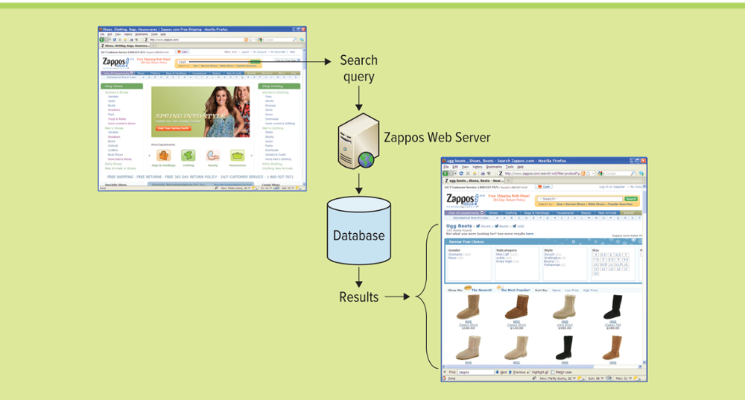
Figure 6.10 Zappos.com – A Data-Driven Website
在美國，一個華人小伙兒開設的網路鞋店聲名鵲起，堪稱“家喻戶曉”，2007年的銷售額超過8億美元，占美國鞋類網路市場總值30億美元的四分之一強，被稱為“賣鞋的亞馬遜” Zappos 用 12 億美元賣給 Amazon
Jump to long image description
Notes:
Overview of a data-driven website
Zappos, the online shoe retailer
The customer enters search criteria in the website
The database runs a query on the search criteria

Slide 31
Driving Websites with Data 2 of 2
Data-driven website advantages
Easy to manage content
Easy to store large amounts of data
Easy to eliminate human errors
Notes:
Additional Data Driven Website Advantages
Development: Allows the website owner to make changes any time—all without having to rely on a developer or knowing HTML programming. A well-structured, data-driven website enables updating with little or no training.
Content management: A static website requires a programmer to make updates. This adds an unnecessary layer between the business and its Web content, which can lead to misunderstandings and slow turnarounds for desired changes.
Future expandability: Having a data-driven website enables the site to grow faster than would be possible with a static site. Changing the layout, displays, and functionality of the site (adding more features and sections) is easier with a data-driven solution.
Minimizing human error: Even the most competent programmer charged with the task of maintaining many pages will overlook things and make mistakes. This will lead to bugs and inconsistencies that can be time consuming and expensive to track down and fix. Unfortunately, users who come across these bugs will likely become irritated and may leave the site. A well-designed, data-driven website will have ”error trapping” mechanisms to ensure that required information is filled out correctly and that content is entered and displayed in its correct format.
Cutting production and update costs: A data-driven website can be updated and ”published” by any competent data entry or administrative person. In addition to being convenient and more affordable, changes and updates will take a fraction of the time that they would with a static site. While training a competent programmer can take months or even years, training a data entry person can be done in 30 to 60 minutes.
More efficient: By their very nature, computers are excellent at keeping volumes of information intact. With a data-driven solution, the system keeps track of the templates, so users do not have to. Global changes to layout, navigation, or site structure would need to be programmed only once, in one place, and the site itself will take care of propagating those changes to the appropriate pages and areas. A data-driven infrastructure will improve the reliability and stability of a website, while greatly reducing the chance of ”breaking” some part of the site when adding new areas.
Improved Stability: Any programmer who has to update a website from ”static” templates must be very organized to keep track of all the source files. If a programmer leaves unexpectedly, it could involve re-creating existing work if those source files cannot be found. Plus, if there were any changes to the templates, the new programmer must be careful to use only the latest version. With a data-driven website, there is peace of mind, knowing the content is never lost, even if your programmer is.

Slide 32
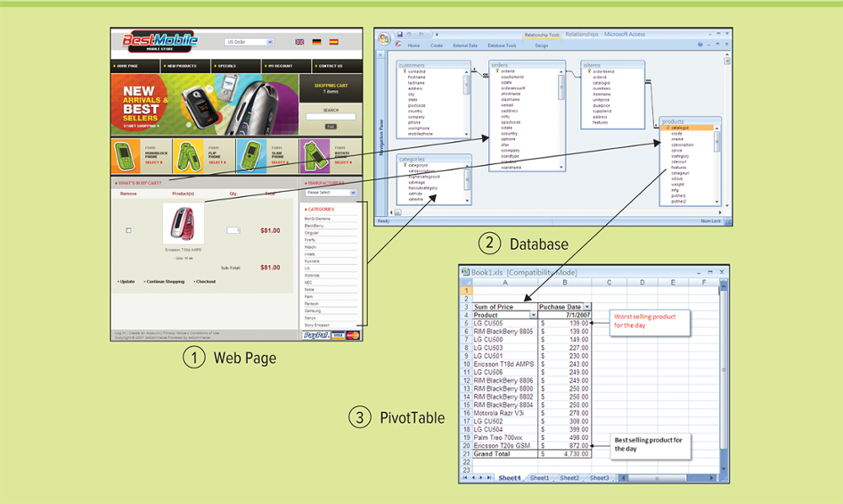
Figure 6.11 BI in a Data-Driven Website
Jump to long image description
Notes:
The above figure displays data-driven BI
The customer enters search criteria in the website
The database runs a query on the search criteria
The company can gain BI by viewing how often items are searched, which item is searched the most, the least, etc.
Companies can gain business intelligence by viewing the data accessed and analyzed from their website. The figure displays how running queries or using analytical tools, such as a Pivot Table, on the database that is attached to the website can offer insight into the business, such as items browsed, frequent requests, items bought together, etc.

Slide 33
Section 6.2
BUSINESS INTELLIGENCE

Slide 34
Learning Outcomes 2 of 2
6.5 Describe the roles and purposes of data warehouses and data marts in an organization.
6.6 Identify the advantages of using business intelligence to support managerial decision making.
6.7 Identify the four common characteristics of Big Data.
6.8 Explain data mining and identify the three elements of data mining.
6.9 Explain the importance of data analytics and data visualization.

Slide 35
Supporting Decisions with Business Intelligence 1 of 2
Data warehouses extend the transformation of data into information
In the 1990’s executives became less concerned with the day-to-day business operations and more concerned with overall business functions
The data warehouse provided the ability to support decision making without disrupting the day-to-day operations
GREAT BUSINESS DECISIONS – Bill Inmon –生於1945年是美國計算機科學家，被許多人認為是資料倉儲之父。Inmon寫了第一本書，與Arnie Barnett舉行了第一次會議，在雜誌上寫了第一篇專欄文章，是第一本提供數據倉庫課程的專欄。 Inmon創建了資料倉儲所接受的定義 - a subject oriented, nonvolatile, integrated, time variant collection of data in support of management's decisions
Notes:
CLASSROOM OPENER
GREAT BUSINESS DECISIONS – Bill Inmon – The Father of the Data Warehouse
Bill Inmon, is recognized as the "father of the data warehouse" and co-creator of the "Corporate Information Factory." He has 35 years of experience in database technology management and data warehouse design. He is known globally for his seminars on developing data warehouses and has been a keynote speaker for every major computing association and many industry conferences, seminars, and tradeshows.
As an author, Bill has written about a variety of topics on the building, usage, and maintenance of the data warehouse and the Corporate Information Factory. He has written more than 650 articles, many of them have been published in major computer journals such as Datamation, ComputerWorld, DM Review and Byte Magazine. Bill currently publishes a free weekly newsletter for the Business Intelligence Network, and has been a major contributor since its inception. http://www.b-eye-network.com/home/

Slide 36
Supporting Decisions with Business Intelligence 2 of 2
Data warehouse – A logical collection of information, gathered from many different operational databases, that supports business analysis activities and decision-making tasks
The primary purpose of a data warehouse is to aggregate information throughout an organization into a single repository for decision-making purposes
Notes:
What is the primary difference between a database and data warehouse?
The primary difference between a database and a data warehouse is that a database stores information for a single application, whereas a data warehouse stores information from multiple databases, or multiple applications, and external information such as industry information
This enables cross-functional analysis, industry analysis, market analysis, etc., all from a single repository
Data warehouses support only analytical processing (OLAP)

Slide 37
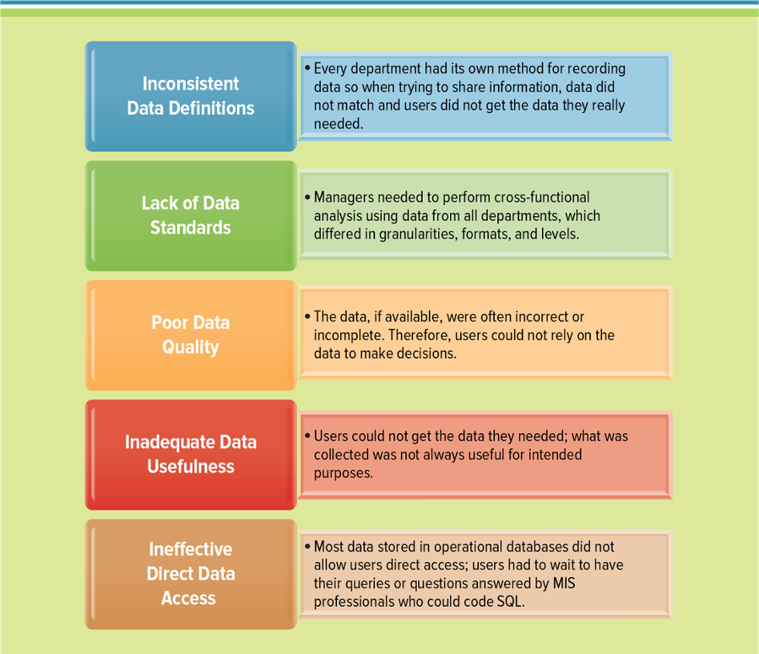
Figure 6.12 Reasons Business Analysis is Difficult from Operational Databases
Jump to long image description
Notes:
This figure displays the reasons business analysis is difficult from operational systems
Ask your students to identify different operational systems in a business
Payroll system
Accounting system
Customer service system
Finance system
Marketing system
Sales system
Legal system
Human resource systems
The operational systems run the business with the transactional data. Performing an analysis from any single operational system would be difficult since they typically come from different vendors, store data differently, and do not always communicate with other operational systems. You must compile all of the operational data into a single data warehouse to run enterprise wide analysis!

Slide 38
Data Marts
Data aggregation – Collection of data from various sources for the purpose of data processing
Extraction, transformation, and loading (ETL) – A process that extracts information from internal and external databases, transforms the information using a common set of enterprise definitions, and loads the information into a data warehouse
Data mart – Contains a subset of data warehouse information
Notes:
The ETL process gathers data from the internal and external databases and passes it to the data warehouse
The ETL process also gathers data from the data warehouse and passes it to the data marts
Each layer in a data warehouse or data mart represents information according to an additional dimension
Dimensions could include such things as:
Products
Promotions
Stores
Category
Region
Stock price
Date
Time
Weather
Why is the ability to look at information based on different dimensions critical to a businesses success?
Ans: The ability to look at information from different dimensions can add tremendous business insight
By slicing-and-dicing the information a business can uncover great unexpected insights

Slide 39
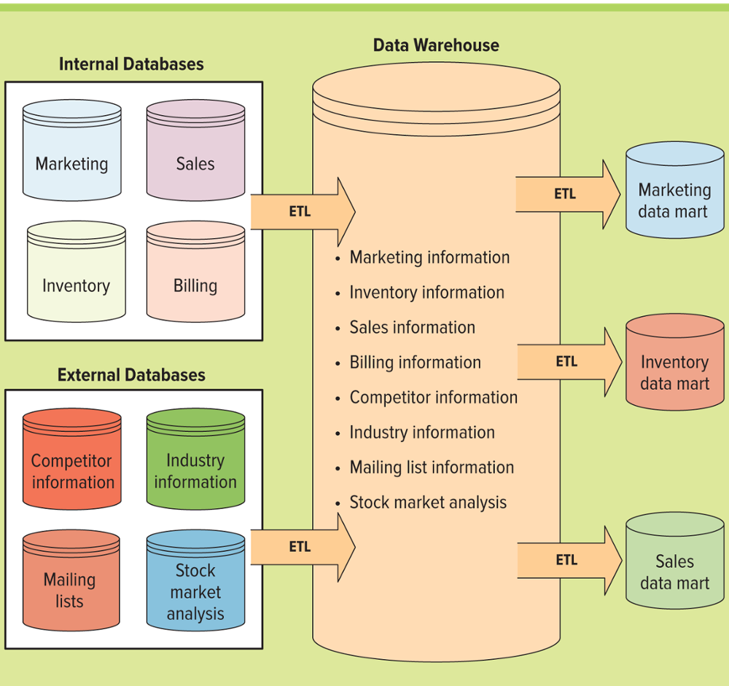
Figure 6.14 Data Warehouse Model
Jump to long image description
Notes:
The data warehouse modeled in the above figure compiles information from internal databases or transactional/operational databases and external databases through ETL
It then send subsets of information to the data marts through the ETL process
Ask your students to distinguish between a data warehouse and a data mart?
Ans: A data warehouse has an enterprisewide organizational focus, while a data mart focuses on a subset of information for a given business unit such as finance

Slide 40
Information Cleansing or Scrubbing
An organization must maintain high-quality data in the data warehouse
Dirty data – Erroneous or flawed data
Information cleansing or scrubbing – A process that weeds out and fixes or discards inconsistent, incorrect, or incomplete information
scrub刷掉
Notes:
This is a an excellent time to return to the information learned in Chapter 6 on high-quality and low-quality information
What would happen if the information contained in the data warehouse was only about 70 percent accurate?
Would you use this information to make business decisions?
Is it realistic to assume that an organization could get to a 100% accuracy level on information contained in its data warehouse?
No, it is too expensive

Slide 41
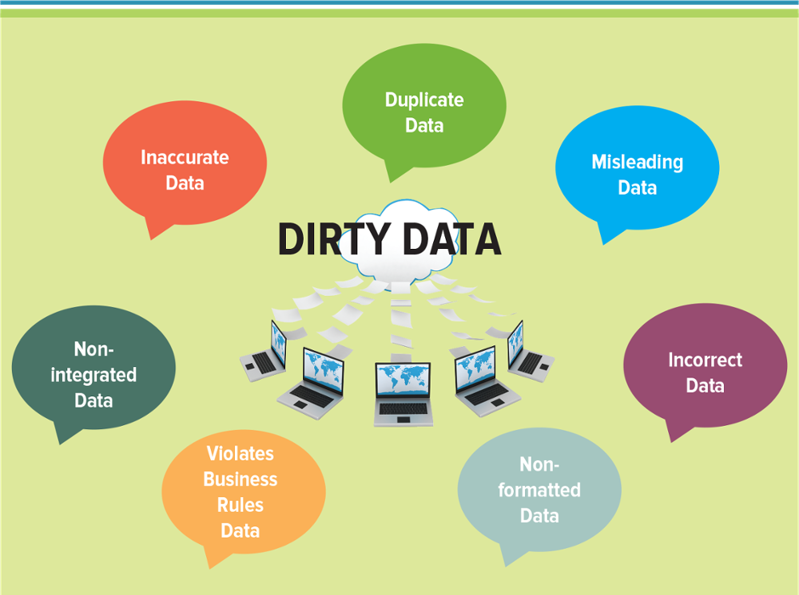
Figure 6.15 Dirty Data Problems
髒data是指沒有進行過data預處理而直接接收到的、處於原始狀態的data
Notes:
How can dirty data impact business reports and analysis?
Garbage In is Garbage Out. If the data used to generate the report is dirty then the report will be inaccurate
Can your students think of any times they have based a decision only to find out the data for the decision was incorrect?

Slide 42
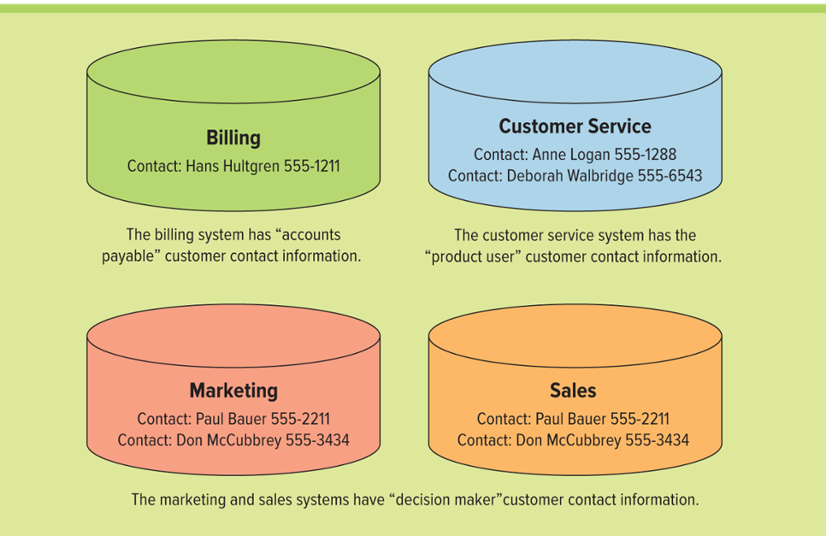
Figure 6.16 Contact Information in Operational Systems
Jump to long image description
Notes:
Taking a look at customer information highlights why information cleansing and scrubbing is necessary
Customer information exists in several operational systems
In each system all details of this customer information could change form the customer ID to contact information
Determining which contact information is accurate and correct for this customer depends on the business process that is being executed

Slide 43
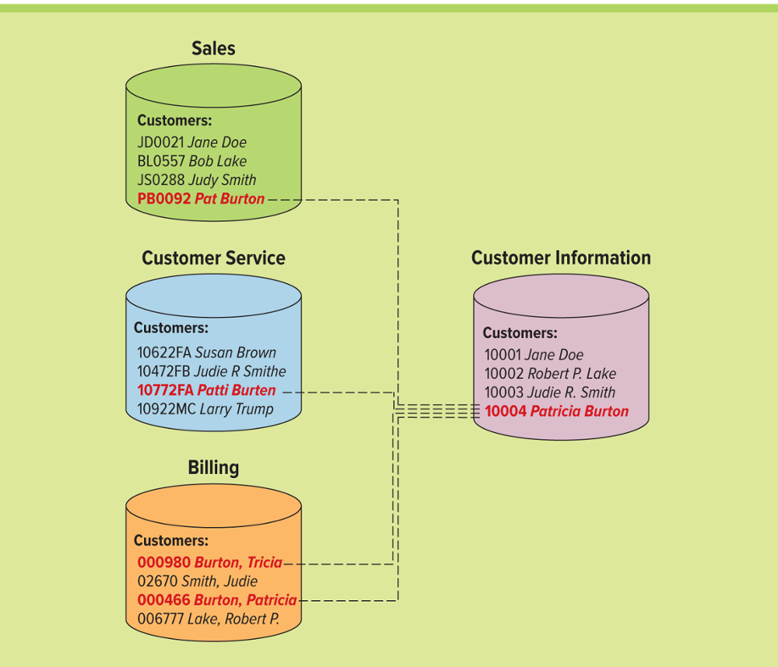
Figure 6.17 Standardizing a Customer Name in Operational Systems
Jump to long image description
Notes:
Ask your students if they have ever received more than one piece of identical mail, such as a flyer, catalog, or application
If so, ask them why this might have occurred
Could it have occurred because their name was in many different disparate systems?
What is the cost to the business of sending multiple identical marketing materials to the same customers?
Expense
Risk of alienating customers

Slide 44
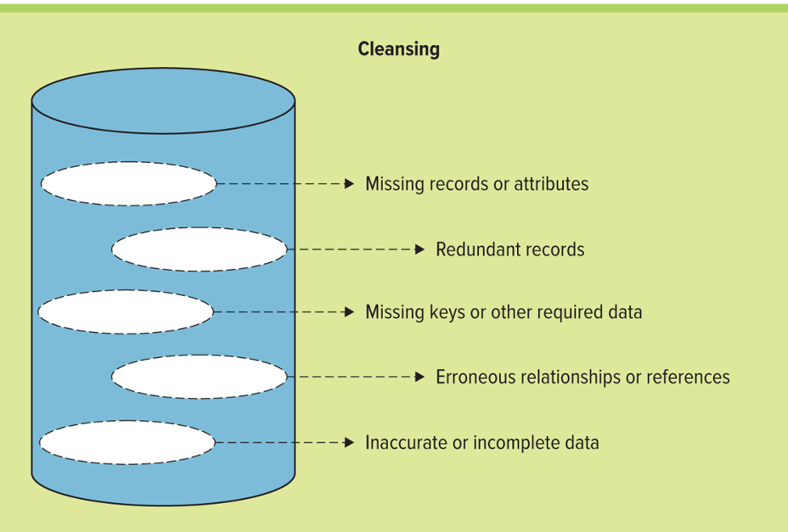
Figure 6.18 Information Cleansing Activities
Jump to long image description
Notes:
Information cleansing allows an organization to fix these types of inconsistencies and cleans the data in the data warehouse
Ask your students if they have any examples of data they have used to make a decision that was incorrect?

Slide 45
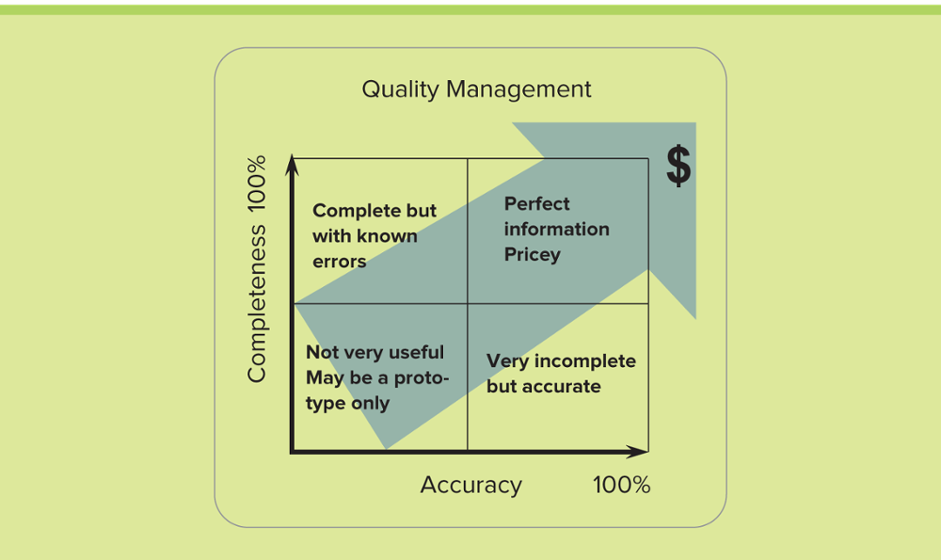
Figure 6.19 The Cost of Accurate and Complete Information
Most organizations determine a percentage high enough to make good decisions at a reasonable cost, such as 85% accurate and 65% complete
pricey 昂贵的
Notes:
Why do you think most businesses cannot achieve 100% accurate and complete information?
If they had to choose a percentage for acceptable information what would it be and why?
Some companies are willing to go as low as 20% complete just to find business intelligence
Few organizations will go below 50% accurate, he information is useless if it is not accurate
Achieving perfect information is almost impossible
The more complete and accurate an organization wants to get its information, the more it costs
The tradeoff between perfect information lies in accuracy verses completeness
Accurate information means it is correct, while complete information means there are no blanks
Most organizations determine a percentage high enough to make good decisions at a reasonable cost, such as 85% accurate and 65% complete

Slide 46
Business Intelligence 1 of 2
Organizational data is difficult to access
Organizational data contains structured data in database
Organizational data contains unstructured data such as voice mail, phone calls, text messages, and video clips
Clips剪輯
Notes:
To jumpstart this lecture search the Internet to find current statistics on the rate that data is growing
Due, in part, to this Internet of Things, the digital universe is doubling in size every two years and will multiply 10-fold between 2013 and 2020 – from 4.4 trillion gigabytes to 44 trillion gigabytes.
For Perspective:
The amount of information in the digital universe would fill a stack* of iPad Air tablets reaching 2/3 of the way to the moon (157,674 miles/253,704 kilometers). By 2020, there will be 6.6 stacks.
Today, the average household creates enough data to fill 65 iPhones (32gb) per year. In 2020, this will grow to 318 iPhones.
Today, if a byte of data were a gallon of water, in only 10 seconds there would be enough data to fill an average house. In 2020, it will only take 2 seconds

Slide 47
Business Intelligence 2 of 2
Data point – An individual item on a graph or a chart
Data broker – A business that collects personal information about consumers and sells that information to other organizations
Data lake – A storage repository that holds a vast amount of raw data in its original format until the business needs it
資料湖 (Data Lake) 的概念最早出現在 2011 年 Forbes 雜誌中的一篇文章 ”Big Data Requires a Big, New Architecture” 當中。
有別於資料倉儲 (Data Warehouse) 的資料通常品質較高而且有被預先處理過，資料湖 (DL) 可以容納任何類型、大量且龐雜的資料，作為資料素材 (Data Material) 的儲存池 (Pool) ，方便人們未來分析、使用。
Notes:
Ask your students to define the relationship between a data point, data broker, and data lake
Data points are two pieces of raw data that have an intersection or correlation
Data points are in a data lake
A data broker collects data in a data lake

Slide 48
The Problem: Data Rich, Information Poor
Many organizations find themselves in the position of being data rich and information poor
Even in today’s electronic world, managers struggle with the challenge of turning their business data into business intelligence
Notes:
As businesses increase their reliance on enterprise systems such as CRM, they are rapidly accumulating vast amounts of data. Every interaction between departments or with the outside world, historical information on past transactions, as well as external market information, is entered into information systems for future use and access.

Slide 49
The Solution: Business Intelligence 1 of 2
Improving the quality of business decisions has a direct impact on costs and revenue
BI enables business users to receive data for analysis that is:
Reliable
Consistent
Understandable
Easily manipulated
零售和銷售：預測銷售; 確定商店之間正確的庫存水平和分銷時間表; 和防止損失。
銀行業務：預測不良貸款和欺詐性信用卡使用的水平，新客戶的信用卡支出
運營管理：預測機器故障; 找到控制製造能力優化的關鍵因素。
經紀和證券交易：預測債券價格何時會發生變化; 確定何時買入或賣出股票。
保險：預測索賠金額和醫療保險費用; 對影響醫療保險的最重要因素進行分類; 預測哪些客戶會購買新的保險單。
Notes:
For instance, giving a customer a discount may or may not help the bottom line, depending on the profitability of the client over the duration of the relationship.
To improve the quality of business decisions, managers can provide existing staff with BI systems and tools that can assist them in making better, more informed decisions.
The result creates an agile intelligent enterprise.
A few examples of using BI to make informed business decisions include:
Retail and sales: Predicting sales; determining correct inventory levels and distribution schedules among outlets; and loss prevention.
Banking: Forecasting levels of bad loans and fraudulent credit card use, credit card spending by new customers, and which kinds of customers will best respond to (and qualify for) new loan offers.
Operations management: Predicting machinery failures; finding key factors that control optimization of manufacturing capacity.
Brokerage and securities trading: Predicting when bond prices will change; forecasting the range of stock fluctuations for particular issues and the overall market; determining when to buy or sell stocks.
Insurance: Forecasting claim amounts and medical coverage costs; classifying the most important elements that affect medical coverage; predicting which customers will buy new insurance policies.

Slide 50
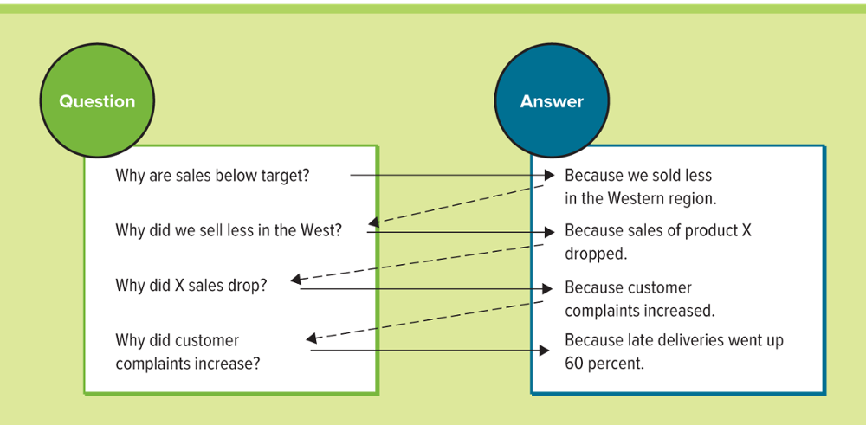
Figure 6.20 How BI Can Answer Tough Customer Questions
business一直在哪裡:確定趨勢和模式時，歷史觀點始終是重要的。
business現在在哪裡:目前的情況對於修改是否至關重要，如果不能接受，鼓勵它們朝著正確的方向發展。
business在不久的將來:能夠有把握地預測公司的方向對於合理的規劃和創建合理的business戰略至關重要。
Jump to long image description
Notes:
The figure displays how organizations using BI can find the root causes to problems and provide solutions simply by asking “Why?” The process is initiated by analyzing a global report, say of sales per quarter.
Every answer is followed by a new question, and users can drill deep down into a report to get to fundamental causes.
Once they have a clear understanding of root causes, they can take highly effective action.
Finding the answers to tough business questions by using data that is reliable, consistent, understandable, and easily manipulated allows a business to gain valuable insight into such things as:
Where the business has been. Historical perspective is always important in determining trends and patterns of behavior.
Where it is now. Current situations are critical to either modify if not acceptable or encourage if they are trending in the right direction.
And where it will be in the near future. Being able to predict with surety the direction of the company is critical to sound planning and to creating sound business strategies.

Slide 51
The Solution: Business Intelligence 2 of 2
Competitive monitoring – A company keeps tabs of its competitor's activities on the web using software that automatically tracks all competitor website activities such as discounts and new products
Data map – A technique for establishing a match, or balance, between the source data and the target data warehouse
Data-driven decision management – An approach to business governance that values decisions評估決策that can be backed up with verifiable data
Keep tab of密切關注
Notes:
A data map is a technique for establishing a match, or balance, between the source data and the target data warehouse.
This technique identifies data shortfalls and recognizes data issues. Data maps can also alert managers to inconsistencies or help determine the cause and effects of enterprise-wide business decisions.
Data-driven decision management is an approach to business governance that values decisions that can be backed up with verifiable data.
The success of the data-driven approach is reliant upon the quality of the data gathered and the effectiveness of its analysis and interpretation.

Slide 52
The Power of Big Data Analytics 1 of 2
Big data – A collection of large, complex data sets, including structured and unstructured data, which cannot be analyzed using traditional database methods and tools and includes the following four common characteristics:
Variety
Veracity (value)
Volume
Velocity
Variety: Different forms of structured and unstructured data
Data from email, videos, photos, and PDFs, all of which must be analyzed
Veracity: The uncertainty of data, including biases, noise, Uncertainty or untrustworthiness of data
Data must be meaningful to the problem being analyzed
Must keep data clean and implement processes to keep dirty data from accumulating in systems
Volume: The scale of data
Includes enormous volumes of data generated daily
Massive volume created by machines and networks
Velocity: The analysis of streaming data as it travels around the Internet
Analysis necessary of social media messages spreading globally,
Notes:
Variety: Different forms of structured and unstructured data
Data from spreadsheets and databases as well as from email, videos, photos, and PDFs, all of which must be analyzed
Veracity: The uncertainty of data, including biases, noise, and abnormalities
Uncertainty or untrustworthiness of data
Data must be meaningful to the problem being analyzed
Must keep data clean and implement processes to keep dirty data from accumulating in systems
Volume: The scale of data
Includes enormous volumes of data generated daily
Massive volume created by machines and networks
Big data tools necessary to analyze zettabytes and brontobytes
Velocity: The analysis of streaming data as it travels around the Internet
Analysis necessary of social media messages spreading globally,

Slide 53
Figure 6.23 Structured and Unstructured Data Examples
Structured Data | Unstructured Data
Sensor data | Satellite images
Weblog data | Photographic data
Financial data | Video data
Click-stream data | Social media data
Point of sale data | Text message
Accounting data | Voice mail data
Notes:
Structured data and unstructured data was introduced in Chapter 1.
It is important to remind students that big data includes both structured and unstructured data. Unstructured data is far more difficult to store, analyze, and mine.

Slide 54
The Power of Big Data Analytics 2 of 2
The two primary computing models that have shaped the collection of big data include:
Distributed computing – Processes and manages algorithms across many machines in a computing environment
Virtualization – The creation of a virtual (rather than actual) version of computing resources, such as an operating system, a server, a storage device, or network resources
虛擬化 - 計算資源虛擬版本的（而非實際）創建，例如操作系統，server，存儲設備或網絡資源
Notes:
Big data depends on distributed computing environments and virtualization.
Distributed computing allows processes to be run over multiple machines taking advantage of greater processing power
Virtualization allows the cost of big data to decrease since multiple applications can run on one machine. It also helps reduce ewaste!

Slide 55
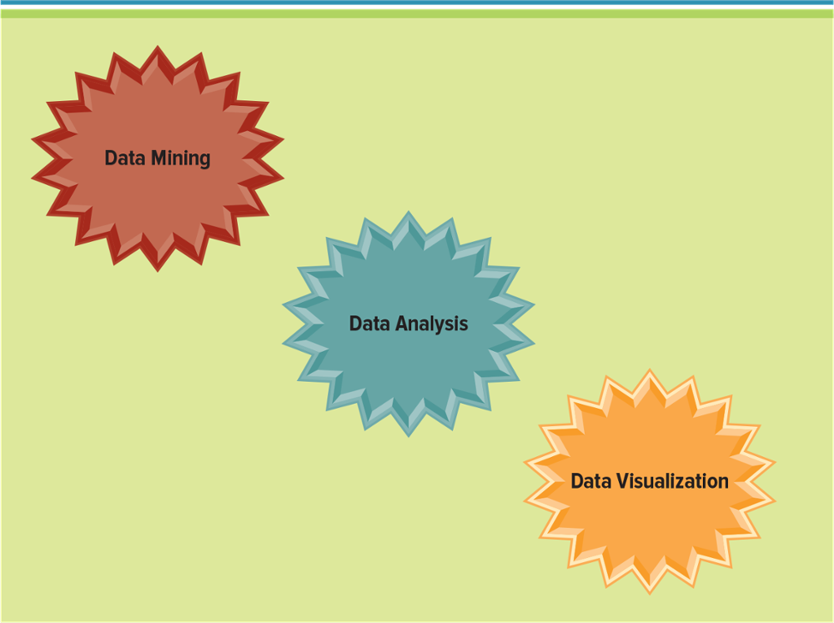
Figure 6.26 Business Focus Areas of Big Data
Notes:
The remainder of the chapter focuses on data mining, data analysis, and data visualization

Slide 56
Data Mining
Data mining – The process of analyzing data to extract information not offered by the raw data alone
The three elements of data mining include:
Data – Foundation for data-directed decision making
Discovery – Process of identifying new patterns, trends, and insights
Deployment – Process of implementing discoveries to drive success
Notes:
Data mining: The process of analyzing data to extract information not offered by the raw data alone
Data mining can begin at a summary information level (coarse granularity) and progress through increasing levels of detail (drilling down), or the reverse (drilling up)
Ask your students to provide an example of what an accountant might discover through the use of data-mining
Ans: An accountant could drill down into the details of all of the expense and revenue finding great business intelligence including which employees are spending the most amount of money on long-distance phone calls to which customers are returning the most products
Could the data warehousing team at Enron have discovered the accounting inaccuracies that caused the company to go bankrupt?
If the did spot them, what should the team have done?

Slide 57
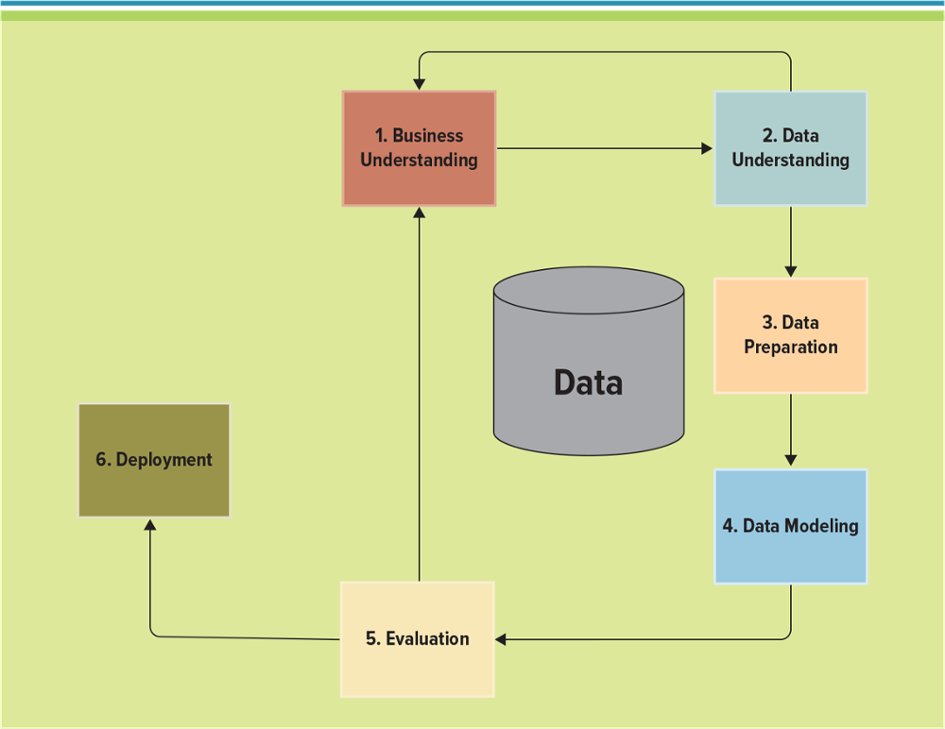
Figure 6.27 Data Mining Process Model Overview
Jump to long image description
Notes:
CLASSROOM EXERCISE
Mining Physician Data: Ethics and BI
Pharmaceutical companies are mining data to determine the correlation between doctors and the drugs they prescribe. They use this information to arm their sales force with physician data for success during sales calls. Answer the following questions:
Do you agree that mining physician data should be illegal? Why or why not?
As a patient how do you feel about pharmaceutical companies mining your doctor's data?
As an employee of one of the pharmaceutical companies how do you feel about mining physician data?

Slide 58
Data Mining Analysis Techniques
Data profiling – The process of collecting statistics and information about data in an existing source
Data replication – The process of sharing information to ensure consistency between multiple data sources
Recommendation engine – A data mining algorithm that analyzes a customer's purchases and actions on a website and then uses the data to recommend complementary products
Notes:
Data profiling is the process of collecting statistics and information about data in an existing source. Insights extracted from data profiling can determine how easy or difficult it will be to use existing data for other purposes along with providing metrics on data quality.
Data replication is the process of sharing information to ensure consistency between multiple data sources. Data mining can determine relationships among such internal factors as price, product positioning, or staff skills, and external factors such as economic indicators, competition, and customer demographics
A recommendation engine is a data mining algorithm that analyzes a customer's purchases and actions on a website and then uses the data to recommend complementary products.

Slide 59
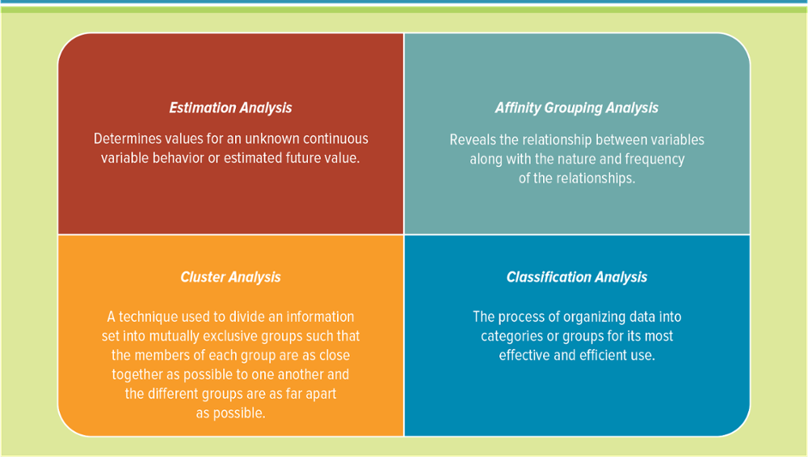
Figure 6.29 Data Mining Techniques
Jump to long image description
Notes:
Classification: Assigns records to one of a predefined set of classes
Estimation: Determines values for an unknown continuous variable behavior or estimated future value
Affinity grouping: Determines which things go together
Clustering: Segments a heterogeneous population of records into a number of more homogeneous subgroups
Ask your students to create examples for each type of data mining technique
Some examples of cluster analysis include:
Consumer goods by content, brand loyalty or similarity
Product market typology for tailoring sales strategies
Retail store layouts and sales performances
Corporate decision strategies using social preferences
Control, communication, and distribution of organizations
Industry processes, products, and materials
Design of assembly line control functions
Character recognition logic in OCR readers
Data base relationships in management information systems

Slide 60
Data Mining Modeling Techniques for Prediction 1 of 2
Data mining tools – Use a variety of techniques to find patterns and relationships in large volumes of information that predict future behavior and guide decision making
Data mining uncovers patterns and trends such as:
Building budgets and other financial information
Detecting fraud by identifying deceptive spending patterns诈欺的
Finding the best customers who spend the most money
Keeping customers from leaving or migrating to competitors防止
Promoting and hiring employees to ensure success
Notes:
Can your students think of any other examples of data mining?
Predicting customers that might leave for a competitor
Predicting products that sell together
Optimizing customer checkout lines to ensure customers do not have to wait

Slide 61
Data Mining Modeling Techniques for Prediction 2 of 2
Prediction – A statement about what will happen or might happen in the future; for example, predicting future sales or employee turnover
Prediction modeling techniques include:
Optimization modelingA statistical process that finds the way to make a design, system, or decision as effective as possible;
Forecasting modeling
Regression modeling
Notes:
Optimization model
A statistical process that finds the way to make a design, system, or decision as effective as possible; for example:
Finding the values of controllable variables that determine maximal productivity or minimal waste
Determining which products to produce given a limited amount of ingredients
Choosing a combination of projects to maximize overall earnings.
Forecasting model
Time-series information is time-stamped information collected at a particular frequency.
Forecasts are predictions based on time-series information, allowing users to manipulate the time series for forecasting activities.
Web visits per hour
Sales per month
Customer service calls per day
Regression model
A statistical process for estimating the relationships among variables.
Regression models include many techniques for modeling and analyzing several variables when the focus is on the relationship between a dependent variable and one or more independent variables:
Predict the winners of a marathon based on gender, height, weight, hours of training.
Explain how the quantity of weekly sales of a popular brand of beer depend on its price at a small chain of supermarkets.

Slide 62
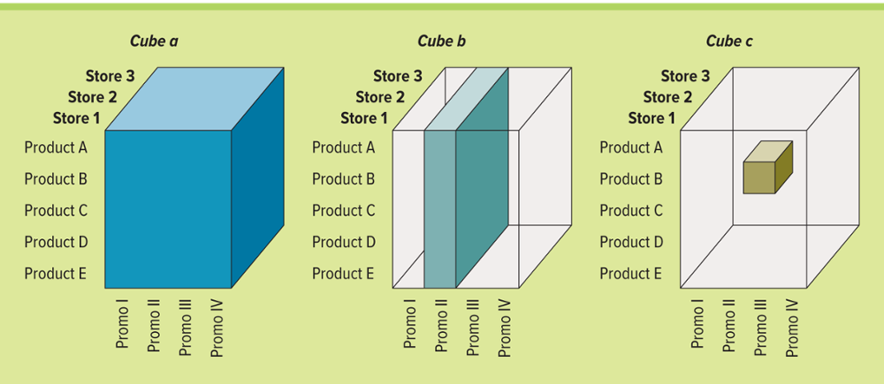
Figure 6.34 A Cube of Information for Performing a Multidimensional Analysis on Three Stores for Five Products and Four Promotions
Cube A represents store information, product information, and promotion information
Cube B represents a slice of information displaying promotion II for all products at all stores
Cube C represents a slice of information displaying promotion III for product B at store 2
Jump to long image description
Notes:
Users can slice and dice the cube to drill down into the information
Cube A represents store information (the layers), product information (the rows), and promotion information (the columns)
Cube B represents a slice of information displaying promotion II for all products at all stores
Cube C represents a slice of information displaying promotion III for product B at store 2
CLASSROOM EXERCISE
Analyzing Multiple Dimensions of Information
Jump! is a company that specializes in making sports equipment, primarily basketballs, footballs, and soccer balls. The company currently sells to four primary distributors and buys all of its raw materials and manufacturing materials from a single vendor. Break your students into groups and ask them to develop a single cube of information that would give the company the greatest insight into its business (or business intelligence) given the following choices:
Product A, B, C, and D
Distributor X, Y, and Z
Promotion I, II, and III
Sales
Season
Date/Time
Salesperson Karen and John
Vendor Smithson
Remember you can pick only 3 dimensions of information for the cube, they need to pick the best 3
Product
Sales
Promotion
These give the three most business-critical pieces of information

Slide 63
Advanced Data Analytics 1 of 2
Algorithms – Mathematical formulas placed in software that performs an analysis on a data set. Algorithms help uncover:
Anomaly detection – The process of identifying rare or unexpected items or events in a data set that do not conform to other items in the data set异常
Outliers – A data value that is numerically distant from most of the other data points in a set of data
Analysis paralysis – User goes into an emotional state of over-analysis (or over-thinking) a situation so that a decision or action is never taken, in effect paralyzing the outcome大家往往困在資料、報表和筆記中無法脫身，這種現象稱為「分析造成的癱瘓」，資料的蒐集永無止境，以致於沒有人有辦法把資料整合成有用的資訊，更不要說一個有條理的解決方法。
Notes:
Explain to your students that it is important to find outliers because they will skew analysis results
Analysis paralysis occurs when the user goes into an emotional state of over-analysis (or over-thinking) a situation so that a decision or action is never taken, in effect paralyzing the outcome
Ask your students to describe a time they experienced analysis/paralysis
Netflix offers a great example. How much time do they spend trying to determine which movie to watch when there are so many options?

Slide 64
Advanced Data Analytics 2 of 2
Fast data - The application of big data analytics to smaller data sets in near-real or real-time in order to solve a problem or create business value
Data scientists perform big data analytics using:
Behavioral analysis
Correlation analysis
Exploratory data analysis
Pattern recognition analysis
Social media analysis
Speech analysis
Text analysis
Web analysis
“快速數據”是由計算機/社會科學專家John Furrier創造的術語。 快速數據是所謂的大數據的“表親”，意味著能夠做出近乎及時的決策，並使企業決策所用時間及數量立即得到改善。
Notes:
Data scientist: Extracts knowledge from data by performing statistical analysis, data mining, and advanced analytics on big data to identify trends, market changes, and other relevant information
Analytics
Behavioral analysis: Using data about people's behaviors to understand intent and predict future actions.
Correlation analysis: Determines a statistical relationship between variables, often for the purpose of identifying predictive factors among the variables.
Exploratory data analysis: Identifies patterns in data, including outliers, uncovering the underlying structure to understand relationships between the variables.
Pattern recognition analysis: The classification or labeling of an identified pattern in the machine learning process.
Social media analysis: Analyzes text flowing across the Internet, including unstructured text from blogs and messages.
Speech analysis: The process of analyzing recorded calls to gather information; brings structure to customer interactions and exposes information buried in customer contact center interactions with an enterprise. Speech analysis is heavily used in the customer service department to help improve processes by identifying angry customers and routing them to the appropriate customer service representative.
Text analysis: Analyzes unstructured data to find trends and patterns in words and sentences. Text mining a firm’s customer support email might identify which customer service representative is best able to handle the question, allowing the system to forward it to the right person.
Web analysis: Analyzes unstructured data associated with websites to identify consumer behavior and website navigation.

Slide 65
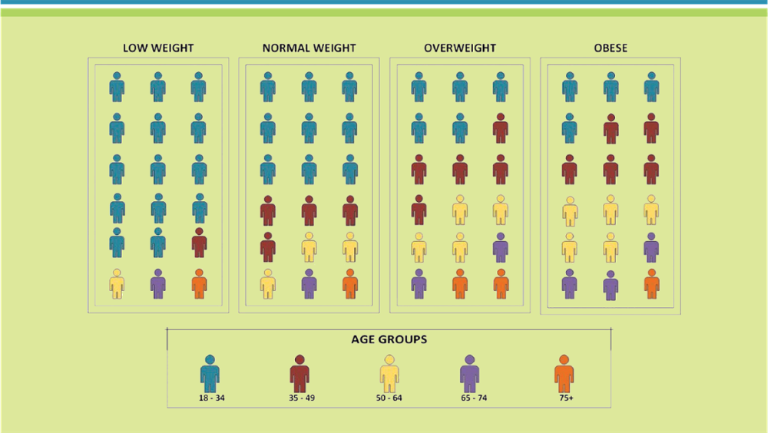
Figure 6.37 Infographic Health Example
Data artists use infographics to display patterns, relationships, and trends in a visual format
Jump to long image description
Notes:
Infographics present the results of data analysis, displaying the patterns, relationships, and trends in a graphical format.
Infographics can present the results of large data analysis looking for patterns and relationships that monitor changes in variables over time.
A data artist is a business analytics specialist who uses visual tools to help people understand complex data.

Slide 66
Data Visualization 1 of 2
Data visualization – Describes technologies that allow users to “see” or visualize data to transform information into a business perspective
Data visualization tools – Move beyond Excel graphs and charts into sophisticated analysis techniques such as pie charts, controls, instruments, maps, time-series graphs, and more
Notes:
Data visualization describes technologies that allow users to “see” or visualize data to transform information into a business perspective.
Data visualization tools move beyond Excel graphs and charts into sophisticated analysis techniques such as pie charts, controls, instruments, maps, time-series graphs, and more.
Data visualization tools can help uncover correlations and trends in data that would otherwise go unrecognized.

Slide 67
Data Visualization 2 of 2
Business intelligence dashboards – Track corporate metrics such as critical success factors and key performance indicators and include advanced capabilities such as interactive controls allowing users to manipulate data for analysis
Notes:
Business intelligence dashboards track corporate metrics such as critical success factors and key performance indicators and include advanced capabilities such as interactive controls allowing users to manipulate data for analysis. The majority of business intelligence software vendors offer a number of different data visualization tools and business intelligence dashboards

Slide 68
Learning Outcome Review
Now that you have finished the chapter please review the learning outcomes in your text.

